Slide 1


ANALYSIS OF ONLINE RETAIL SALES
INFO 523 DATA MINING
COLLEGE OF INFORMATION SCIENCE
TEAM 6:
PRAJWAL SATHYANARAYANA
PRAGNYA NARASIMHA
HEMANATH ARUMUGAM

Slide 2

INTRODUCTION
The Online Retail Dataset provides a comprehensive view of customer purchasing behavior, allowing for an in-depth analysis of sales patterns, customer preferences, and product performance.
Our approach involves implementing a comprehensive data mining strategy, including clustering, association rule mining, and classification algorithms, to analyze and interpret the data.
ANALYSIS OF ONLINE RETAIL SALES | INFO 523 DATA MINING | COLLEGE OF INFORMATION SCIENCE | UNIVERSITY OF ARIZONA
Notes:
- The Online Retail Dataset is a transactional dataset that captures sales data from an e-commerce platform.
- This dataset provides a comprehensive view of customer purchasing behavior, allowing for in-depth analysis of sales patterns, customer preferences, and product performance.

Slide 3

DATASET
Dataset Overview
Name: Online Retail Dataset
Source: UCI Machine Learning Repository
Data Types
Nominal: StockCode, Country, Description
Numerical: Quantity, UnitPrice, Amount
Temporal: InvoiceDate
Key Fields
InvoiceNo, StockCode, Description, Quantity, InvoiceDate, UnitPrice, CustomerID, Country
Dataset Size
~400,000 transactions
ANALYSIS OF ONLINE RETAIL SALES | INFO 523 DATA MINING | COLLEGE OF INFORMATION SCIENCE | UNIVERSITY OF ARIZONA
Notes:
- The dataset consists of approximately 500,000 transactions from an online retail store, capturing sales data over a specific period. It includes key attributes such as InvoiceNo, StockCode, Description, Quantity, InvoiceDate, UnitPrice, CustomerID, and Country.

Slide 4
DATA CLEANING
We conducted an initial assessment of the dataset to identify missing values across different columns.
The percentage of missing values was calculated for each column to quantify the data quality.
ANALYSIS OF ONLINE RETAIL SALES | INFO 523 DATA MINING | COLLEGE OF INFORMATION SCIENCE | UNIVERSITY OF ARIZONA

Slide 5
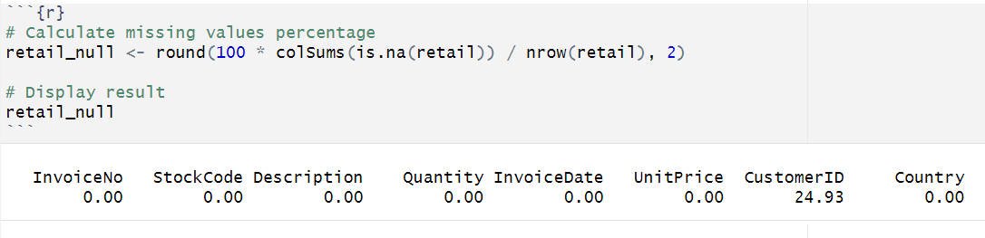
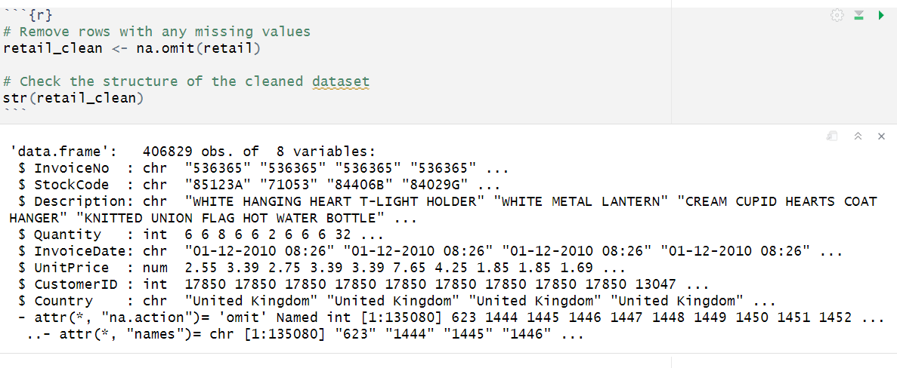
DATA CLEANING
ANALYSIS OF ONLINE RETAIL SALES | INFO 523 DATA MINING | COLLEGE OF INFORMATION SCIENCE | UNIVERSITY OF ARIZONA
Notes:
Here, we can observe that customer id column has around 25% of missing values.
And the rows with missing values are omitted.

Slide 6
DATA PRE PROCESSING
Converted InvoiceDate to a datetime object using dmy_hm() for consistency.
RFM Metrics:
Monetary: Total amount spent by each customer.
Frequency: Number of unique invoices for each customer.
Recency: Days since the last purchase for each customer.
ANALYSIS OF ONLINE RETAIL SALES | INFO 523 DATA MINING | COLLEGE OF INFORMATION SCIENCE | UNIVERSITY OF ARIZONA

Slide 7
DATA PRE PROCESSING
3. Renamed Amount.x to Amount and Amount.y to Monetary for clarity.
4. Computed the difference between the maximum transaction date and individual InvoiceDate (in days) as a new column Diff.
ANALYSIS OF ONLINE RETAIL SALES | INFO 523 DATA MINING | COLLEGE OF INFORMATION SCIENCE | UNIVERSITY OF ARIZONA

Slide 8
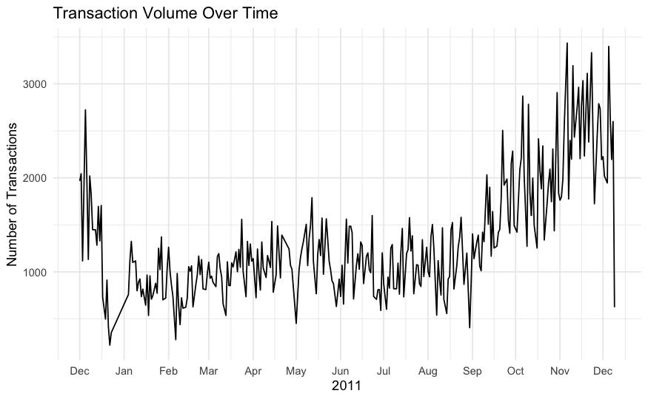
DATA EXPLORATION
Transaction volume exhibits a steady increase starting from mid-year, peaking in the months leading up to December, likely due to holiday shopping.
A notable dip is observed in January, which could be attributed to post-holiday season slowdown.
ANALYSIS OF ONLINE RETAIL SALES | INFO 523 DATA MINING | COLLEGE OF INFORMATION SCIENCE | UNIVERSITY OF ARIZONA

Slide 9
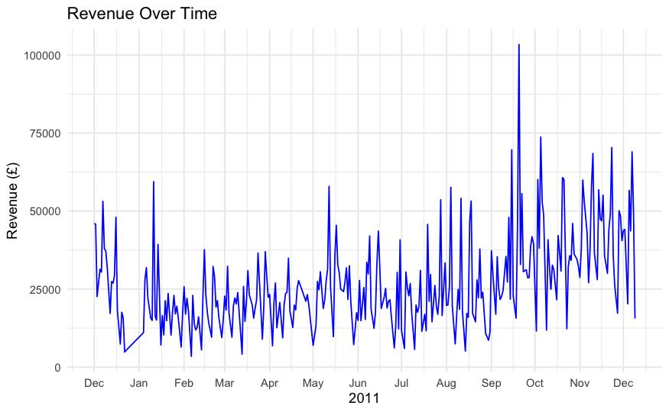
DATA EXPLORATION
Revenue shows a fluctuating pattern, with notable peaks observed in the months of September and December, likely driven by seasonal sales events.
A sharp dip in revenue is evident during January, aligning with post-holiday shopping slowdown.
ANALYSIS OF ONLINE RETAIL SALES | INFO 523 DATA MINING | COLLEGE OF INFORMATION SCIENCE | UNIVERSITY OF ARIZONA

Slide 10
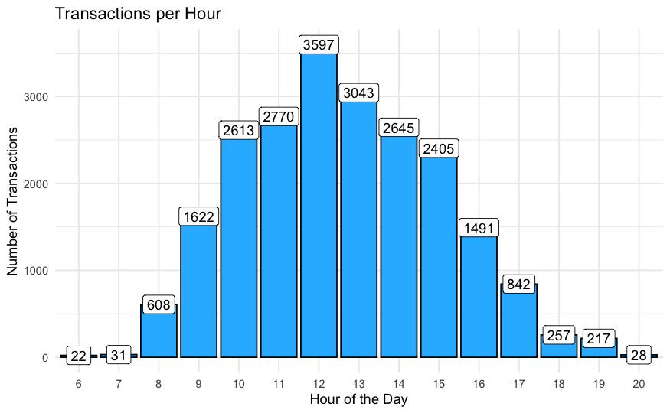
DATA EXPLORATION
Transactions peak during midday hours, particularly between 11:00 AM and 2:00 PM, suggesting a high level of customer activity during this period.
Early morning (before 9:00 AM) and late evening (after 6:00 PM) show significantly lower transaction volumes, indicating reduced business activity during these hours.
ANALYSIS OF ONLINE RETAIL SALES | INFO 523 DATA MINING | COLLEGE OF INFORMATION SCIENCE | UNIVERSITY OF ARIZONA

Slide 11
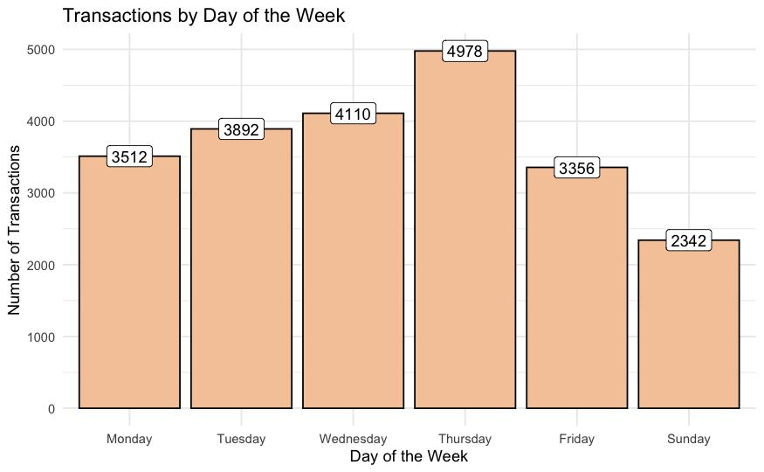
DATA EXPLORATION
Transaction volume is highest on Thursdays and lowest on Sundays, indicating a peak in business activity towards the end of the week.
Weekends (Saturday and Sunday) exhibit lower transaction volumes compared to weekdays, suggesting reduced business operations or customer activity during this period.
ANALYSIS OF ONLINE RETAIL SALES | INFO 523 DATA MINING | COLLEGE OF INFORMATION SCIENCE | UNIVERSITY OF ARIZONA

Slide 12
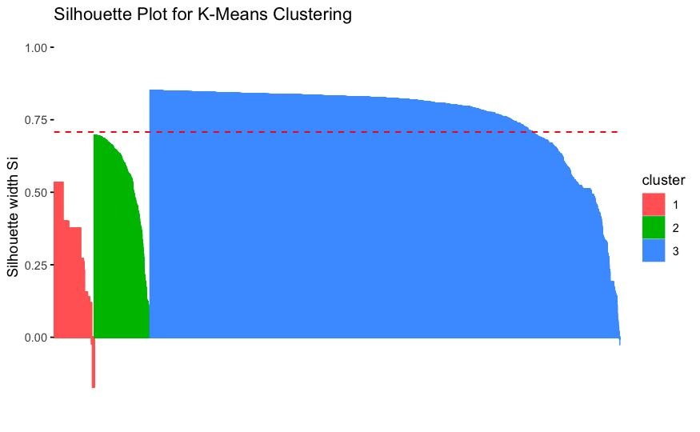
CLUSTERING ALGORITHM - K MEANS CLUSTERING
Cluster Insights: The silhouette plot indicates that Cluster 3 (blue) has the highest cohesion and separation, contributing positively to the clustering quality.
Optimal Clustering: The average silhouette width of ~0.75 demonstrates well-defined clusters, validating the choice of 3 clusters based on the Elbow Method.
ANALYSIS OF ONLINE RETAIL SALES | INFO 523 DATA MINING | COLLEGE OF INFORMATION SCIENCE | UNIVERSITY OF ARIZONA
Average Silhouette score for K Means Clustering is 0.708, implying a strong clustering structure

Slide 13
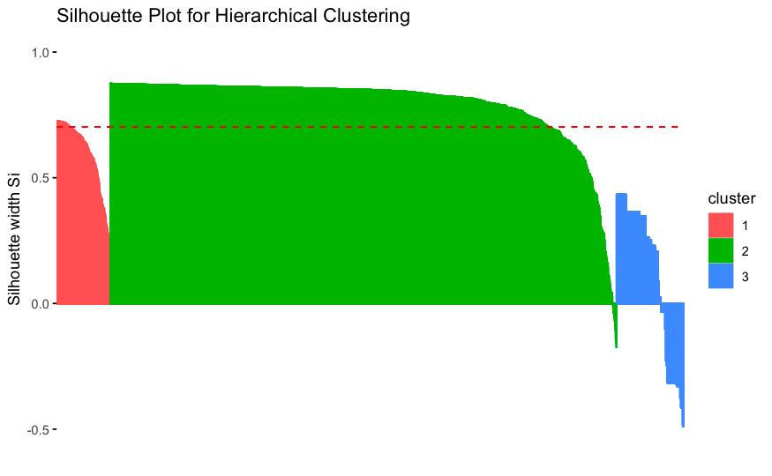
CLUSTERING ALGORITHM - HIERARCHICAL CLUSTERING
Cluster Cohesion and Separation: The silhouette plot demonstrates that Cluster 2 (green) has the highest silhouette width, indicating strong cohesion and clear separation from other clusters, whereas Cluster 3 (blue) shows poor cluster quality.
Hierarchical Clustering Efficiency: With an average silhouette width of approximately 0.5, the clustering structure is moderately defined, suggesting scope for further tuning or testing alternate distance measures.
ANALYSIS OF ONLINE RETAIL SALES | INFO 523 DATA MINING | COLLEGE OF INFORMATION SCIENCE | UNIVERSITY OF ARIZONA
Average Silhouette score for K Means Clustering is 0.702, implying a strong clustering structure

Slide 14
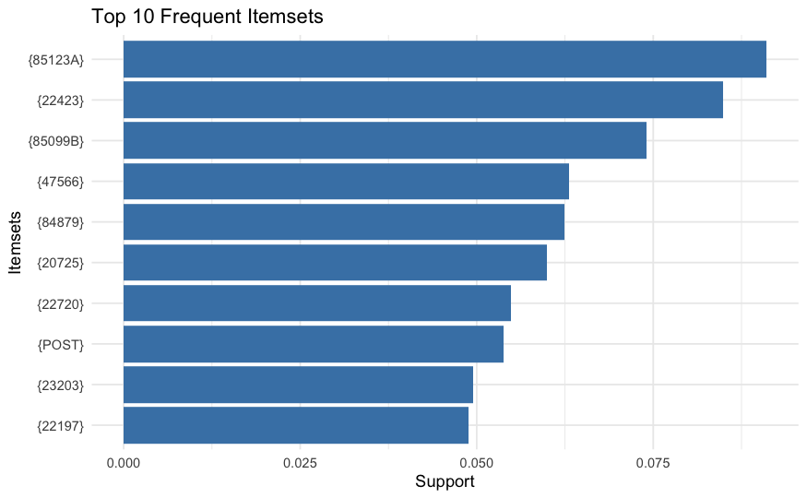
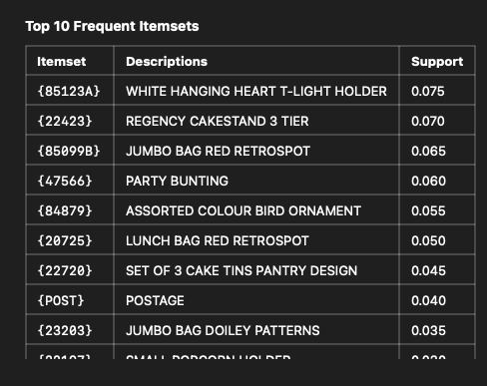
ASSOCIATION ALGORITHM - ECLAT
.
The chart highlights the top 10 most frequent itemsets, with “White Hanging heart light holder” having the highest support at 0.075.
The high support values indicate these items were frequently purchased together, making them significant for association rule mining.
ANALYSIS OF ONLINE RETAIL SALES | INFO 523 DATA MINING | COLLEGE OF INFORMATION SCIENCE | UNIVERSITY OF ARIZONA

Slide 15
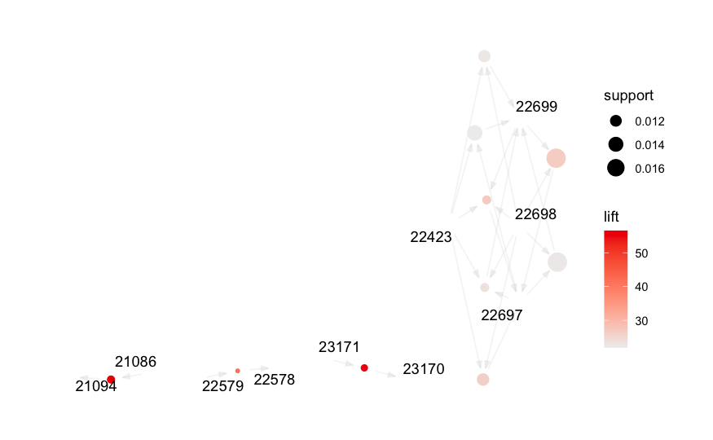
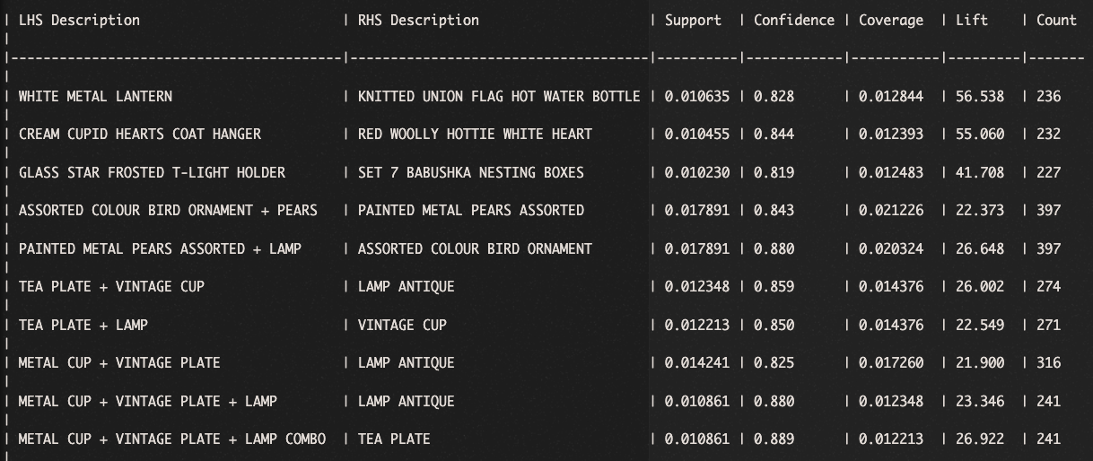
ASSOCIATION ALGORITHM - FP GROWTH ALGORITHM
The graph illustrates association rules with nodes representing items, where larger nodes indicate higher support and darker edges reflect stronger lift values.
Key associations like {23171} → {23170} highlight strong relationships, with lift values above 50, suggesting these items are frequently bought together.
ANALYSIS OF ONLINE RETAIL SALES | INFO 523 DATA MINING | COLLEGE OF INFORMATION SCIENCE | UNIVERSITY OF ARIZONA

Slide 16
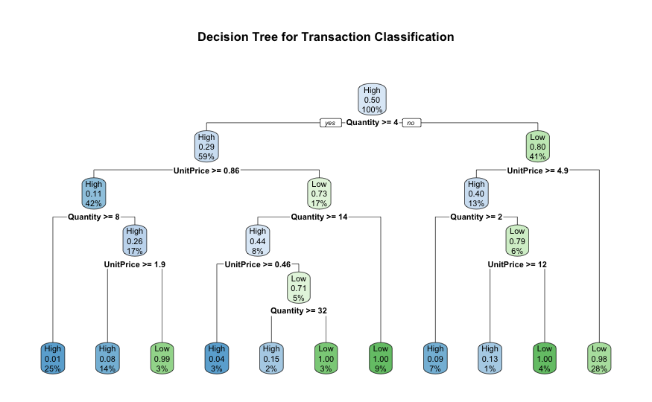
CLASSIFICATION ALGORITHM - DECISION TREE
Decision Tree for Transaction Classification
Creating a target variable AmountCategory that classifies transactions into "High" or "Low" based on the Amount.
Training a decision tree model (rpart) using predictors like Quantity, UnitPrice, Recency, Frequency, and Monetary.
ANALYSIS OF ONLINE RETAIL SALES | INFO 523 DATA MINING | COLLEGE OF INFORMATION SCIENCE | UNIVERSITY OF ARIZONA

Slide 17
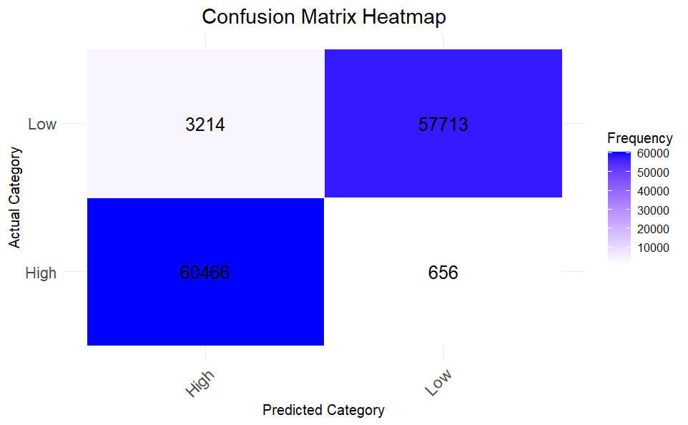
CLASSIFICATION ALGORITHM - DECISION TREE
Accuracy: 0.9682914
Precision (High): 0.9495289
Recall (High): 0.9892674
F1-Score (High): 0.9689909
Precision (Low): 0.9887612
Recall (Low): 0.9472483
F1-Score (Low): 0.9675597
High Precision and Recall with balanced F1-score.
ANALYSIS OF ONLINE RETAIL SALES | INFO 523 DATA MINING | COLLEGE OF INFORMATION SCIENCE | UNIVERSITY OF ARIZONA

Slide 18
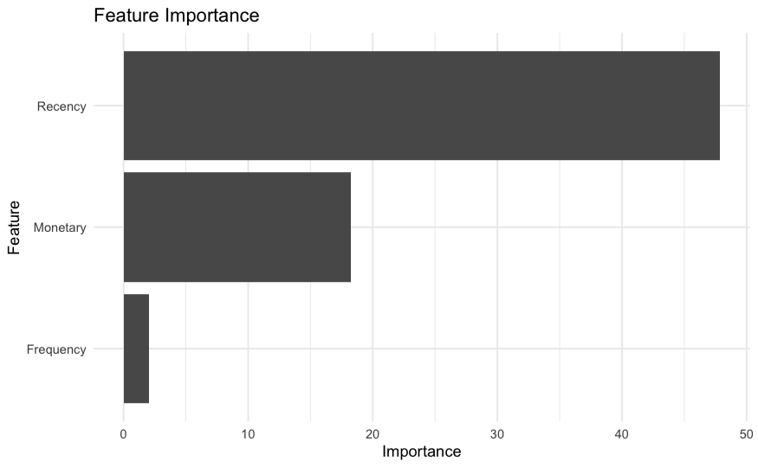
CLASSIFICATION ALGORITHM - RANDOM FOREST
A Random Forest model is trained using Recency, Frequency, and Monetary as predictors.
Customers who haven't made a purchase in the last 6 months are flagged as churned (Churn = 1), while active customers are flagged as 0.
Accuracy: 0.7739464
Precision (Churn): 0.6871036
Recall (Churn): 0.6885593
ANALYSIS OF ONLINE RETAIL SALES | INFO 523 DATA MINING | COLLEGE OF INFORMATION SCIENCE | UNIVERSITY OF ARIZONA

Slide 19

CONCLUSION
Clustering algorithms revealed distinct customer segments based on purchasing behavior, enabling targeted marketing strategies and personalized customer experiences.
Classification models successfully predicted customer purchase probabilities with high accuracy, providing actionable insights for inventory management and sales forecasting.
Association algorithms uncovered significant product relationships and cross-selling opportunities, revealing strategic insights for product placement and promotional campaigns.
ANALYSIS OF ONLINE RETAIL SALES | INFO 523 DATA MINING | COLLEGE OF INFORMATION SCIENCE | UNIVERSITY OF ARIZONA

Slide 20
THANK YOU

